Slide 1
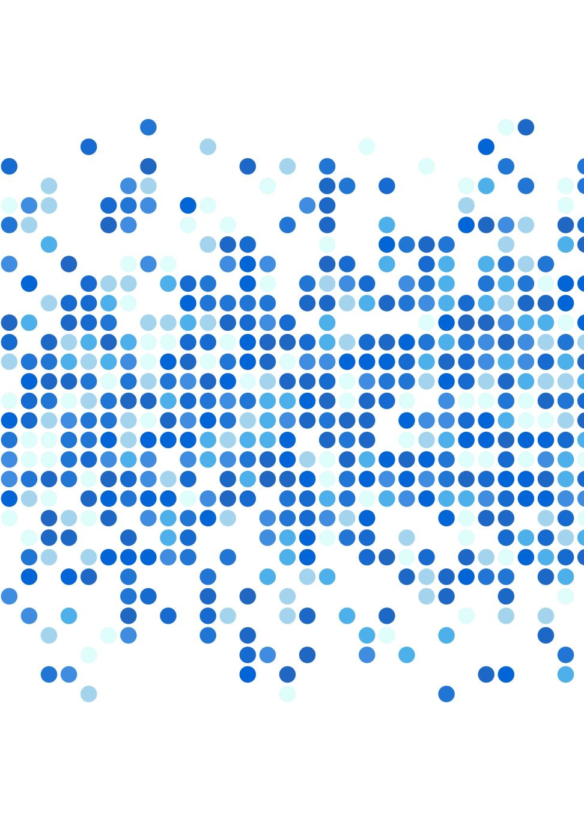
Building Cognitive Architectures
Niek Stevenson, Dora Matzke, Andrew Heathcote
University of Amsterdam

Slide 2
Building Cognitive Architectures
Evidence accumulation models link behavior to latent processes

Slide 3
Building Cognitive Architectures
Evidence accumulation models link behavior to latent processes
Choices and response times arise from competing processes
Model structure encodes assumptions about cognition

Slide 4
Building Cognitive Architectures
Evidence accumulation models link behavior to latent processes
Choices and response times arise from competing processes
Model structure encodes assumptions about cognition
A General Framework for Cognitive Architectures

Slide 5
Evidence Accumulation Models

Slide 6
Evidence Accumulation Models
Accumulators map directly to responses
Extensions have been proposed (e.g., van Ravenzwaaij et. al., 2020)
Van Ravenzwaaij, Brown, Marley & Heathcote (2020 Accumulating advantages: A new conceptualization of rapid multiple choice

Slide 7
Evidence Accumulation Models
Accumulators map directly to responses
Extensions have been proposed (e.g., van Ravenzwaaij et. al., 2020)
Constrains the hypothesis space implicitly
Van Ravenzwaaij, Brown, Marley & Heathcote (2020 Accumulating advantages: A new conceptualization of rapid multiple choice

Slide 8

Hypothesis formulation
Decision-making hypotheses are structural:

Slide 9
Hypothesis formulation
Decision-making hypotheses are structural:
Which processes are present?

Slide 10
Hypothesis formulation
Decision-making hypotheses are structural:
Which processes are present?
How do these processes interact or compete?

Slide 11
Hypothesis formulation
Decision-making hypotheses are structural:
Which processes are present?
How do these processes interact or compete?
How is evidence formed and combined?

Slide 12
Hypothesis formulation
Decision-making hypotheses are structural:
Which processes are present?
How do these processes interact or compete?
How is evidence formed and combined?
In practice:
Competing processes are often reduced to parameter changes

Slide 13
Hypothesis formulation
Competing processes are often reduced to parameter changes:
Working memory
Cognitive control
Perceptual decision-making
Multi-attribute choice (Busemeyer et al. 2019)
Busemeyer, Gluth, Rieskamp & Turner (2019) Cognitive and Neural Bases of Multi-Attribute, Multi-Alternative, Value-based Decisions

Slide 14
Building Cognitive Architectures
A General Framework for Cognitive Architectures:
Logical rules: A not B, A or B, A and B, A stops B

Slide 15
Building Cognitive Architectures
A General Framework for Cognitive Architectures:
Logical rules: A not B, A or B, A and B, A stops B
Ensembles of accumulators

Slide 16
Building Cognitive Architectures
A General Framework for Cognitive Architectures:
Logical rules: A not B, A or B, A and B, A stops B
Ensembles of accumulators
Sequential accumulation

Slide 17
Building Cognitive Architectures
A General Framework for Cognitive Architectures:
Logical rules: A not B, A or B, A and B, A stops B
Ensembles of accumulators
Sequential accumulation
Mixtures, trigger failures

Slide 18
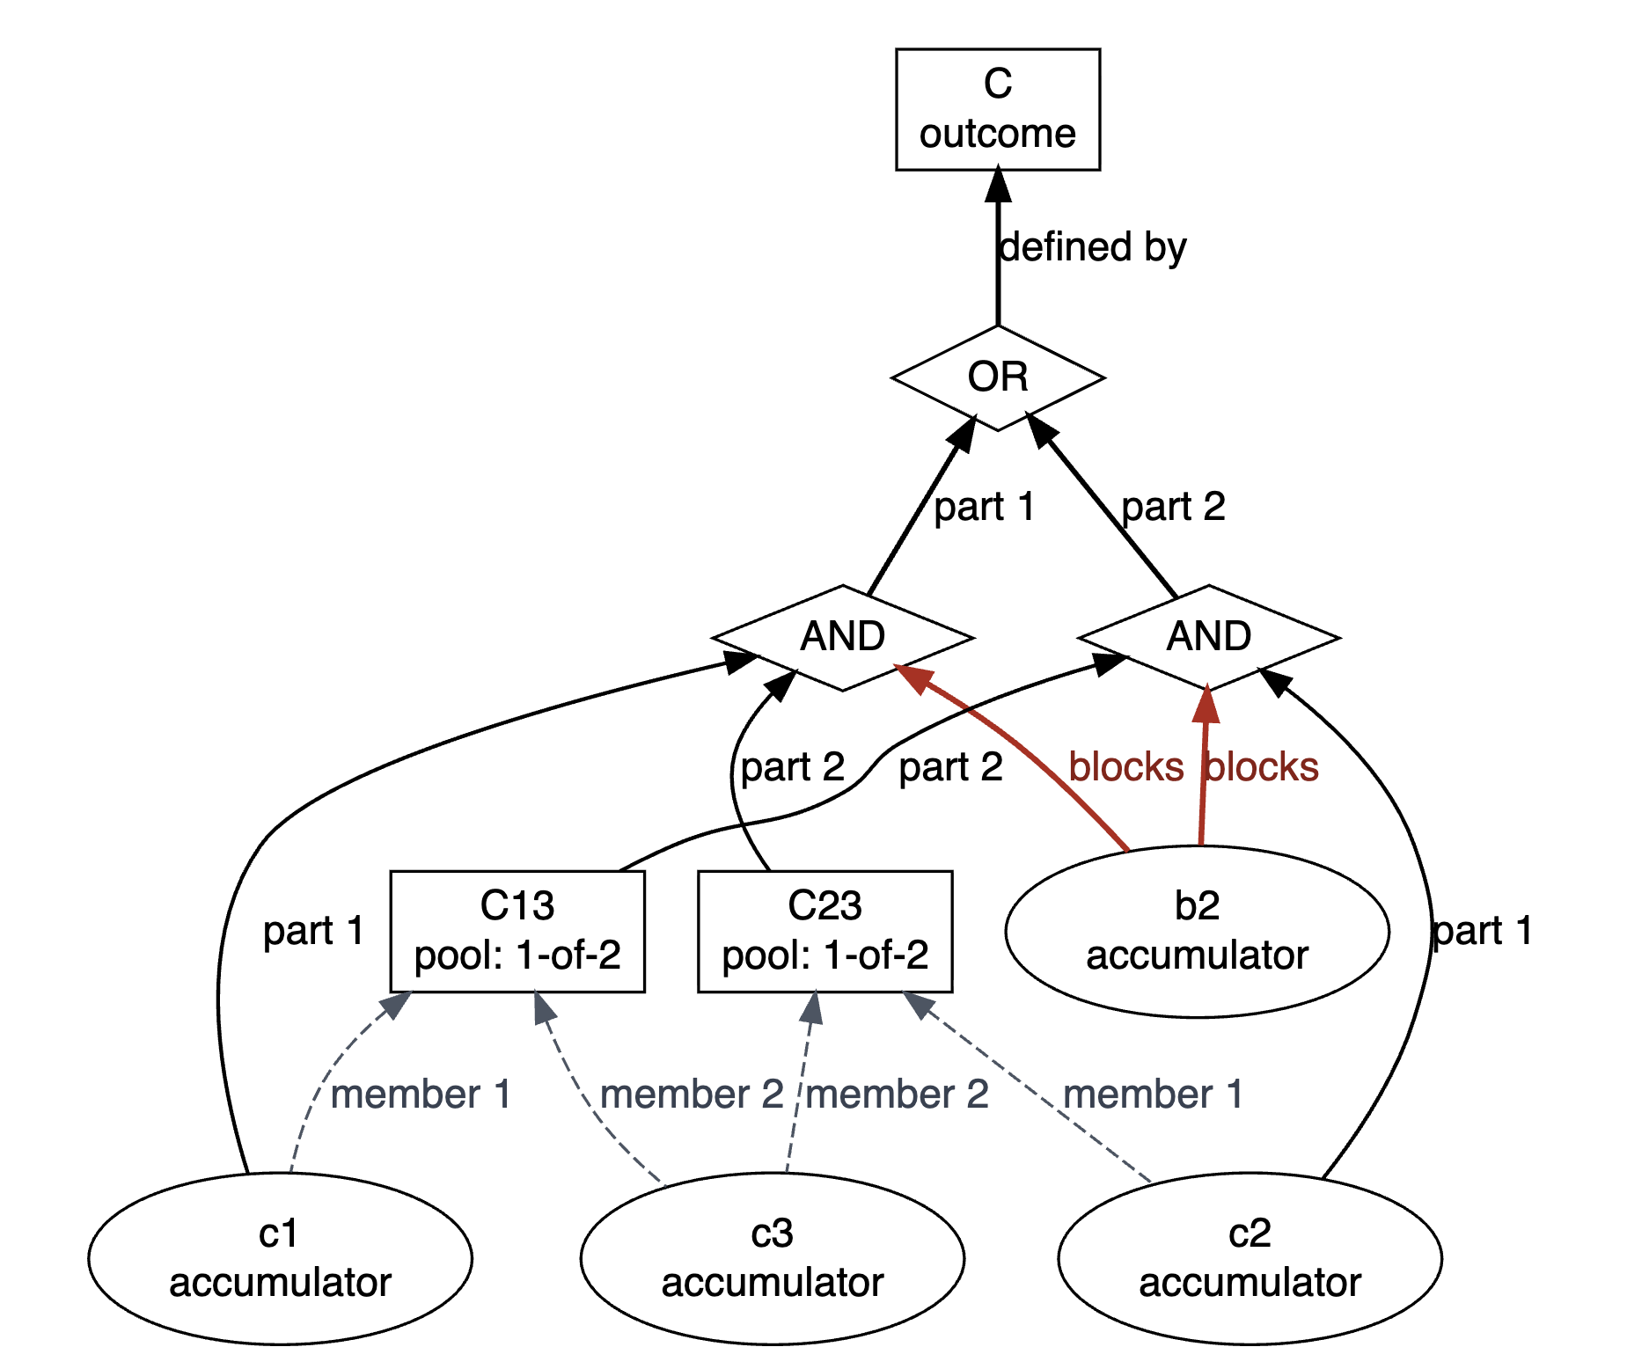
Building Cognitive Architectures
A General Framework for Cognitive Architectures:
Logical rules: A not B, A or B, A and B, A stops B
Ensembles of accumulators
Sequential accumulation
Mixtures, trigger failures
Combinations thereof

Slide 19
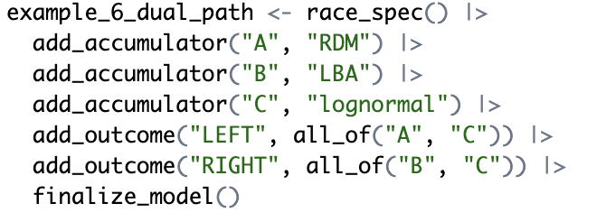
AccumulatR package
R interface, with C++ internals
Functions to define the architecture
Simulation and likelihood evaluation functions
Visualization tools
ADD QR CODE

Slide 20
Applications
Perceptual Decision-Making
Cognitive Control
Stimulus Selective Stopping

Slide 21
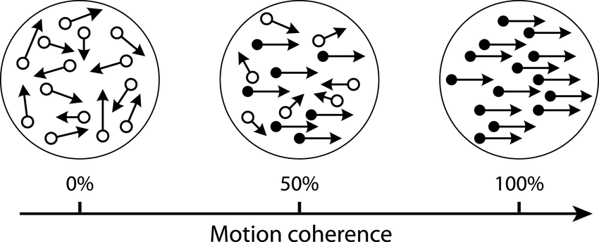
Application 1: Perceptual Decision-Making
Random dot-motion task

Slide 22
Application 1: Perceptual Decision-Making
Random dot-motion task
Two accumulators for each dot (left/right)
Alternatively, if we knew the actual dot directions, one accumulator per dot

Slide 23
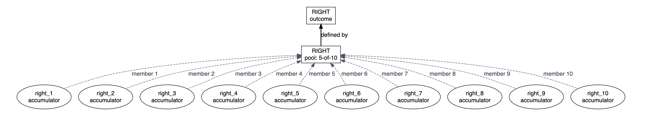
Application 1: Perceptual Decision-Making
Random dot-motion task
Two accumulators for each dot (left/right)
Alternatively, if we knew the actual dot directions, one accumulator per dot
Respond ‘RIGHT’ if more than half of the accumulators say ‘RIGHT’

Slide 24
Application 1: Perceptual Decision-Making
Random dot-motion task
Two accumulators for each dot (left/right)
Alternatively, if we knew the actual dot directions, one accumulator per dot
Respond ‘RIGHT’ if more than half of the accumulators say ‘RIGHT’
Distributional parameters are shared between accumulators so still a sparse model

Slide 25
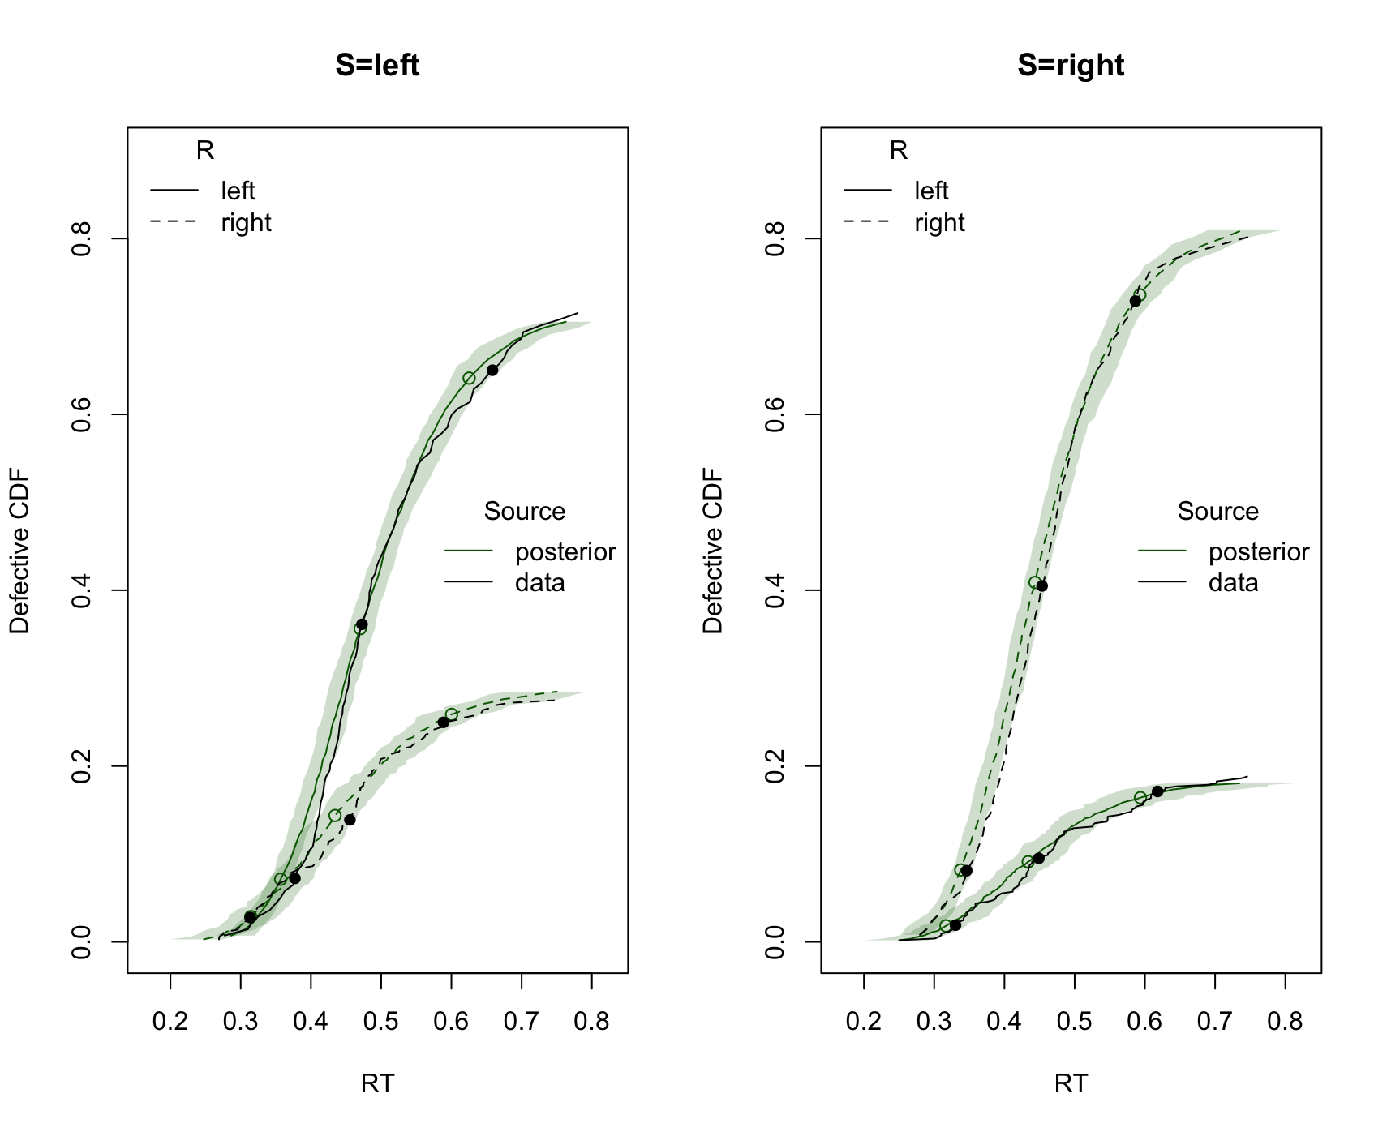
Application 1: Perceptual Decision-Making
Respond ‘RIGHT’ if more than half of the accumulators say ‘RIGHT’
Distributional parameters are shared between accumulators so still a sparse model

Slide 26
Application 2: Cognitive Control
Flanker Task

Slide 27
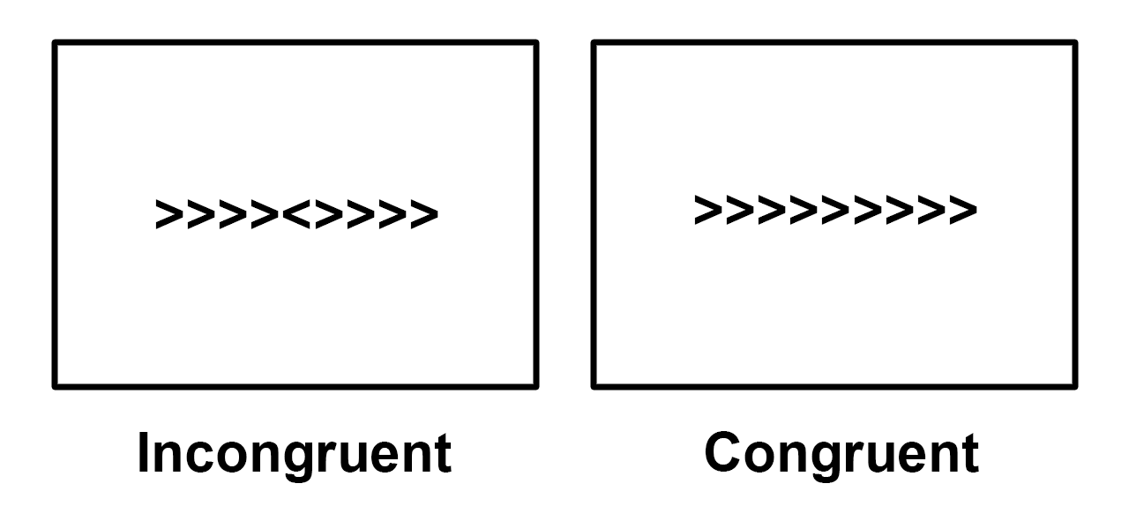
Application 2: Cognitive Control
Flanker Task

Slide 28
Application 2: Cognitive Control
Flanker Task
One accumulator for each arrow
Strength of evidence lower for distractor accumulators

Slide 29
Application 2: Cognitive Control
Flanker Task
One accumulator for each arrow
Strength of evidence lower for distractor accumulators

Slide 30
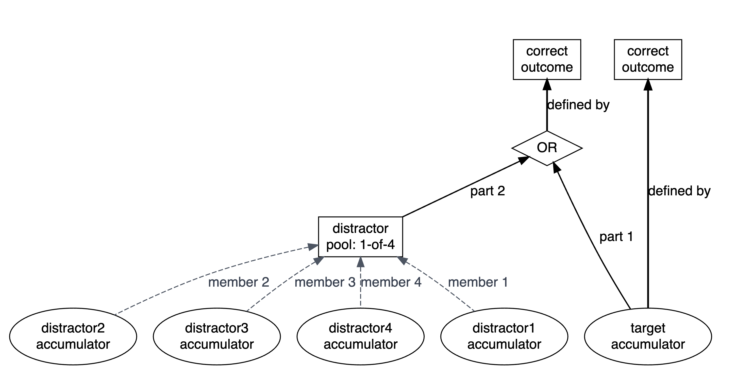
Application 2: Cognitive Control
Flanker Task
One accumulator for each arrow
Strength of evidence lower for distractor accumulators

Slide 31
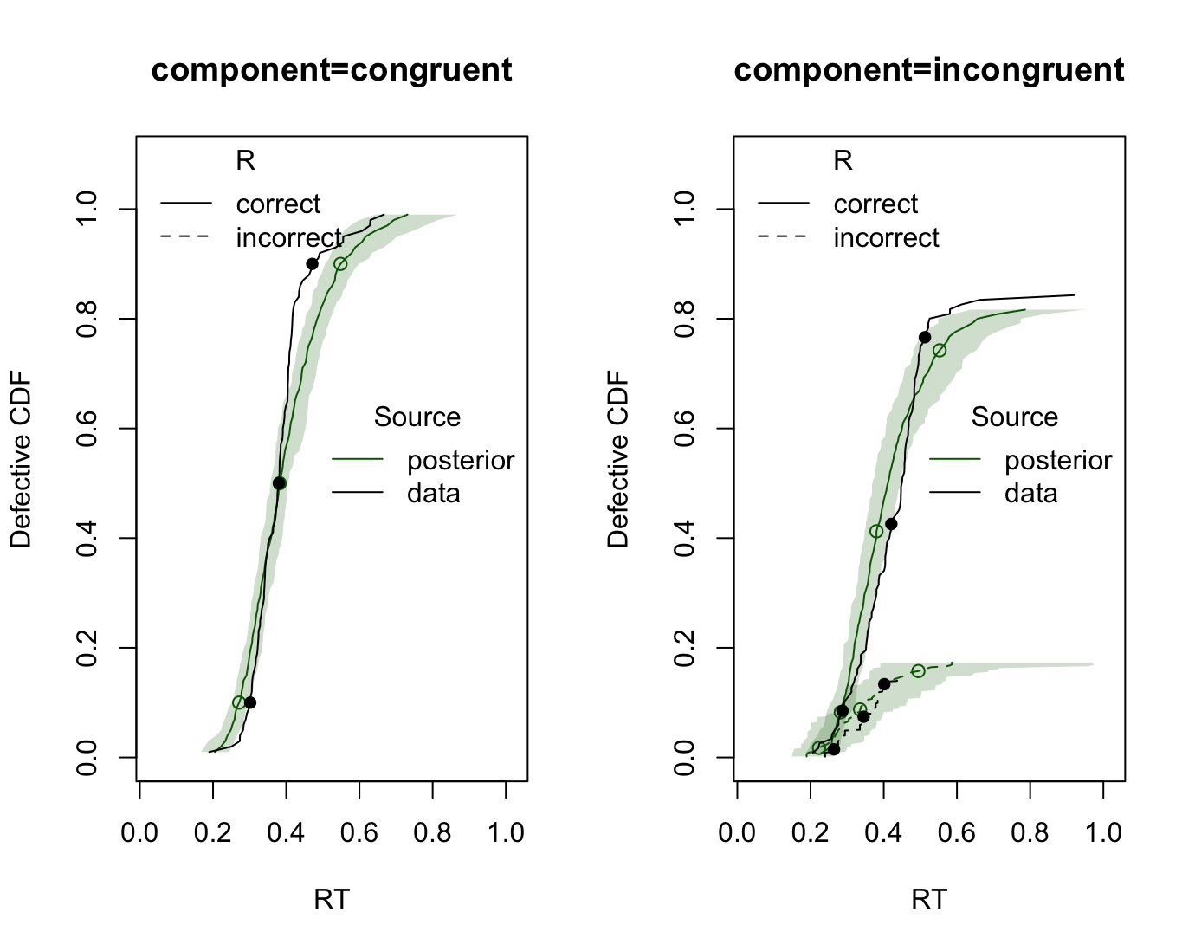
Application 2: Cognitive Control
Flanker Task
One accumulator for each arrow
Strength of evidence lower for distractor accumulators

Slide 32
Application 2: Cognitive Control
Flanker Task
One accumulator for each arrow
Strength of evidence lower for distractor accumulators
No errors on congruent trials

Slide 33
Application 3: Stimulus Selective Stopping

Slide 34
Application 3: Stimulus Selective Stopping
Participants respond to direction of arrow

Slide 35
Application 3: Stimulus Selective Stopping
Stop Signal
Participants respond to direction of arrow
On some trials after a delay a signal appears:
12.5% ignore signal
12.5% stop signal
12.5%
Ignore Signal
12.5%
250 ms

Slide 36
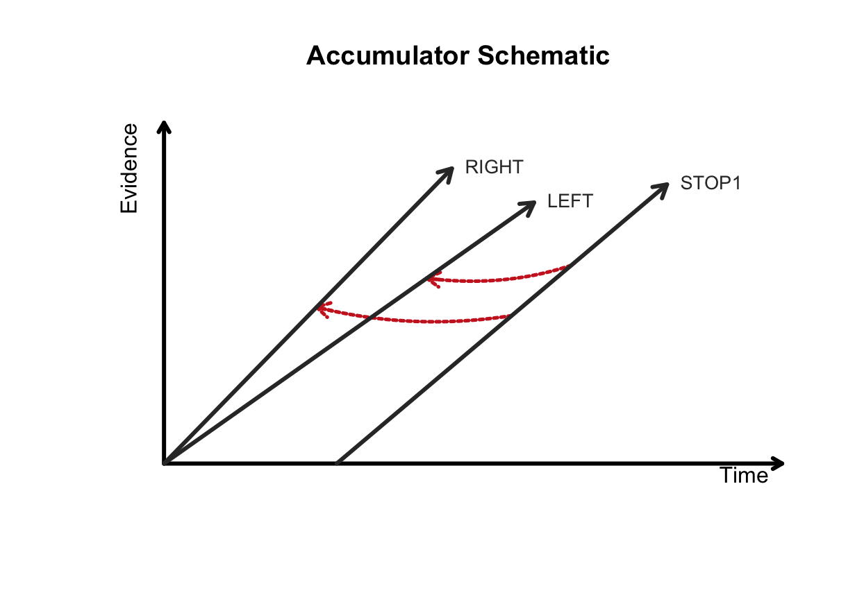
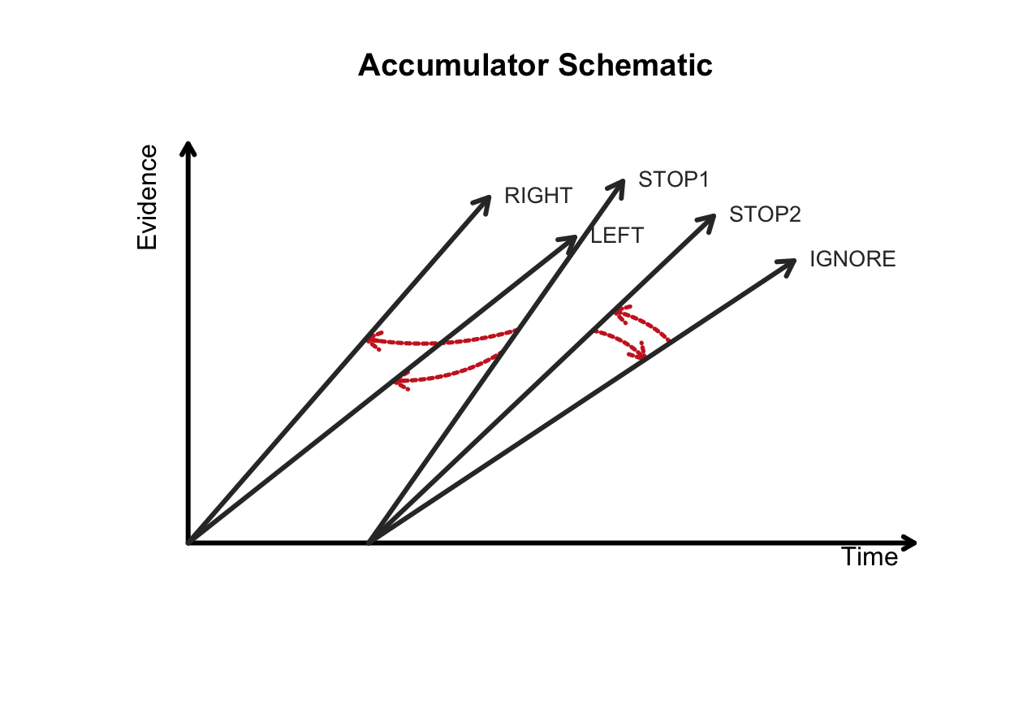
Application 3: Stimulus Selective Stopping
The standard model:
Two go
One stop

Slide 37
Application 3: Stimulus Selective Stopping
Extended model:
Two go
Two stop
One ignore

Slide 38
Application 3: Stimulus Selective Stopping
Extended model:

Slide 39
Application 3: Stimulus Selective Stopping
Extended model:
Two go
Two stop
One ignore
Stop1 stops the go accumulators
Stop2 and Ignore decide whether to stop or ignore

Slide 40
Application 3: Stimulus Selective Stopping
Extended model:
Two go
Two stop
One ignore

Slide 41
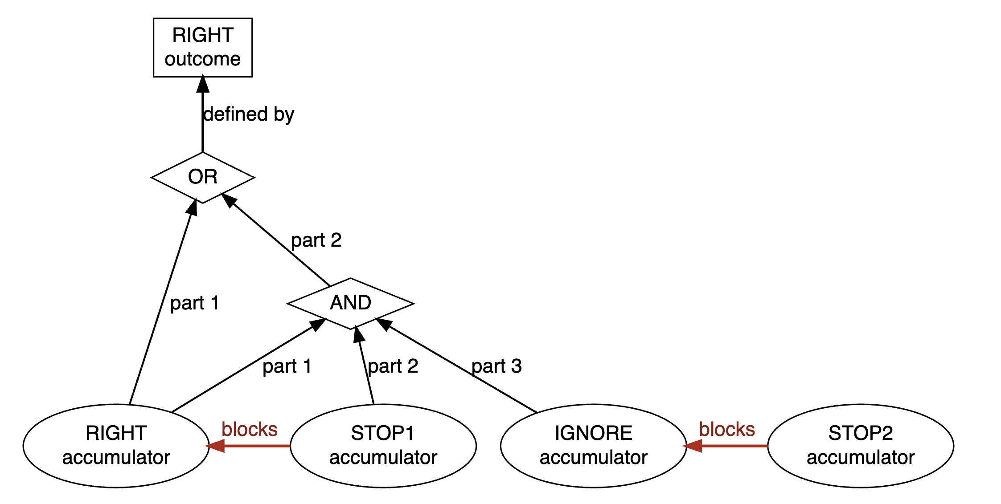
Application 3: Stimulus Selective Stopping
RIGHT vs LEFT vs STOP1
If STOP1 wins
Wait if STOP2 or IGNORE wins

Slide 42
Application 3: Stimulus Selective Stopping
Participants respond to direction of arrow
On some trials after a delay a signal appears:
50% ignore signal
50% stop signal

Slide 43
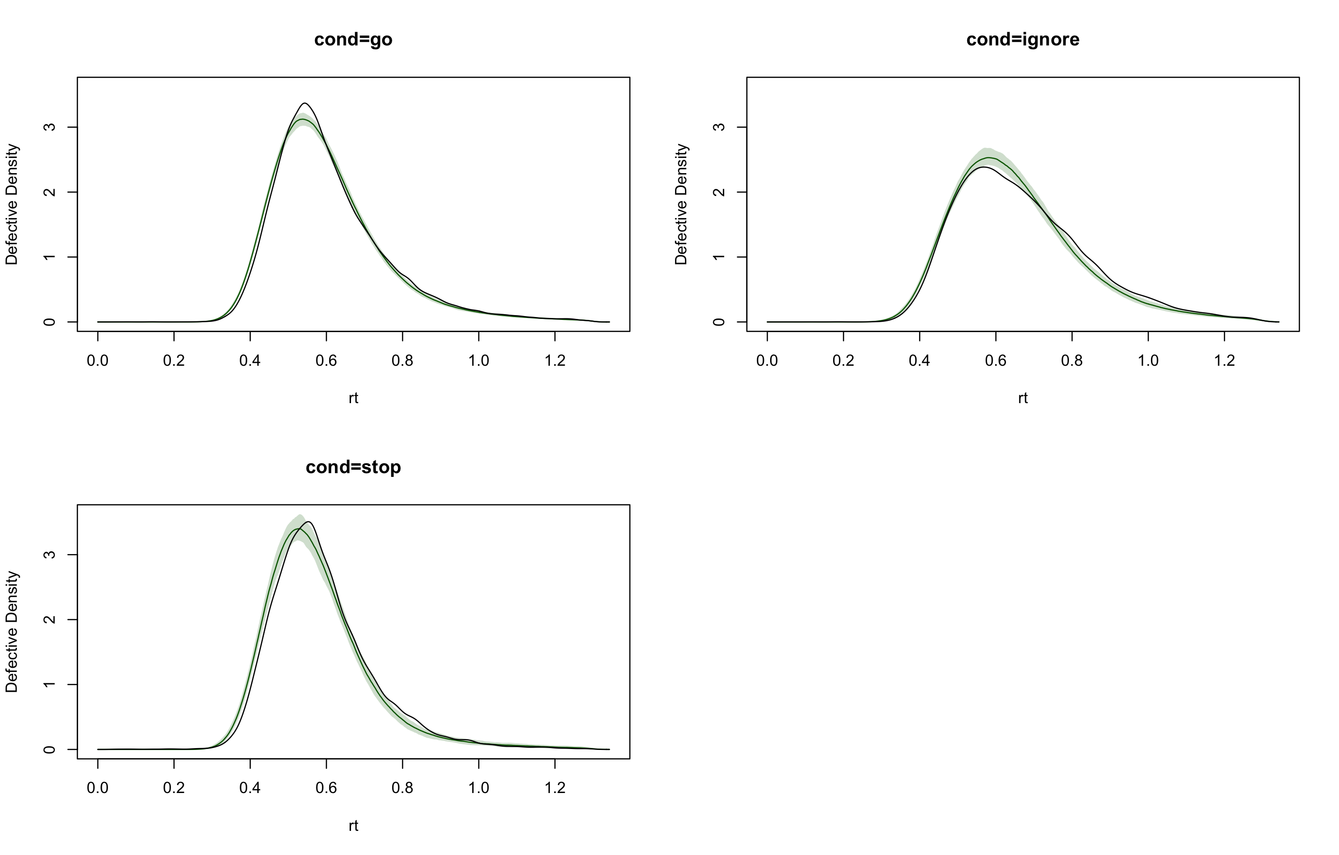
Application 3: Stimulus Selective Stopping
Participants respond to direction of arrow
On some trials after a delay a signal appears:
50% ignore signal
50% stop signal

Slide 44
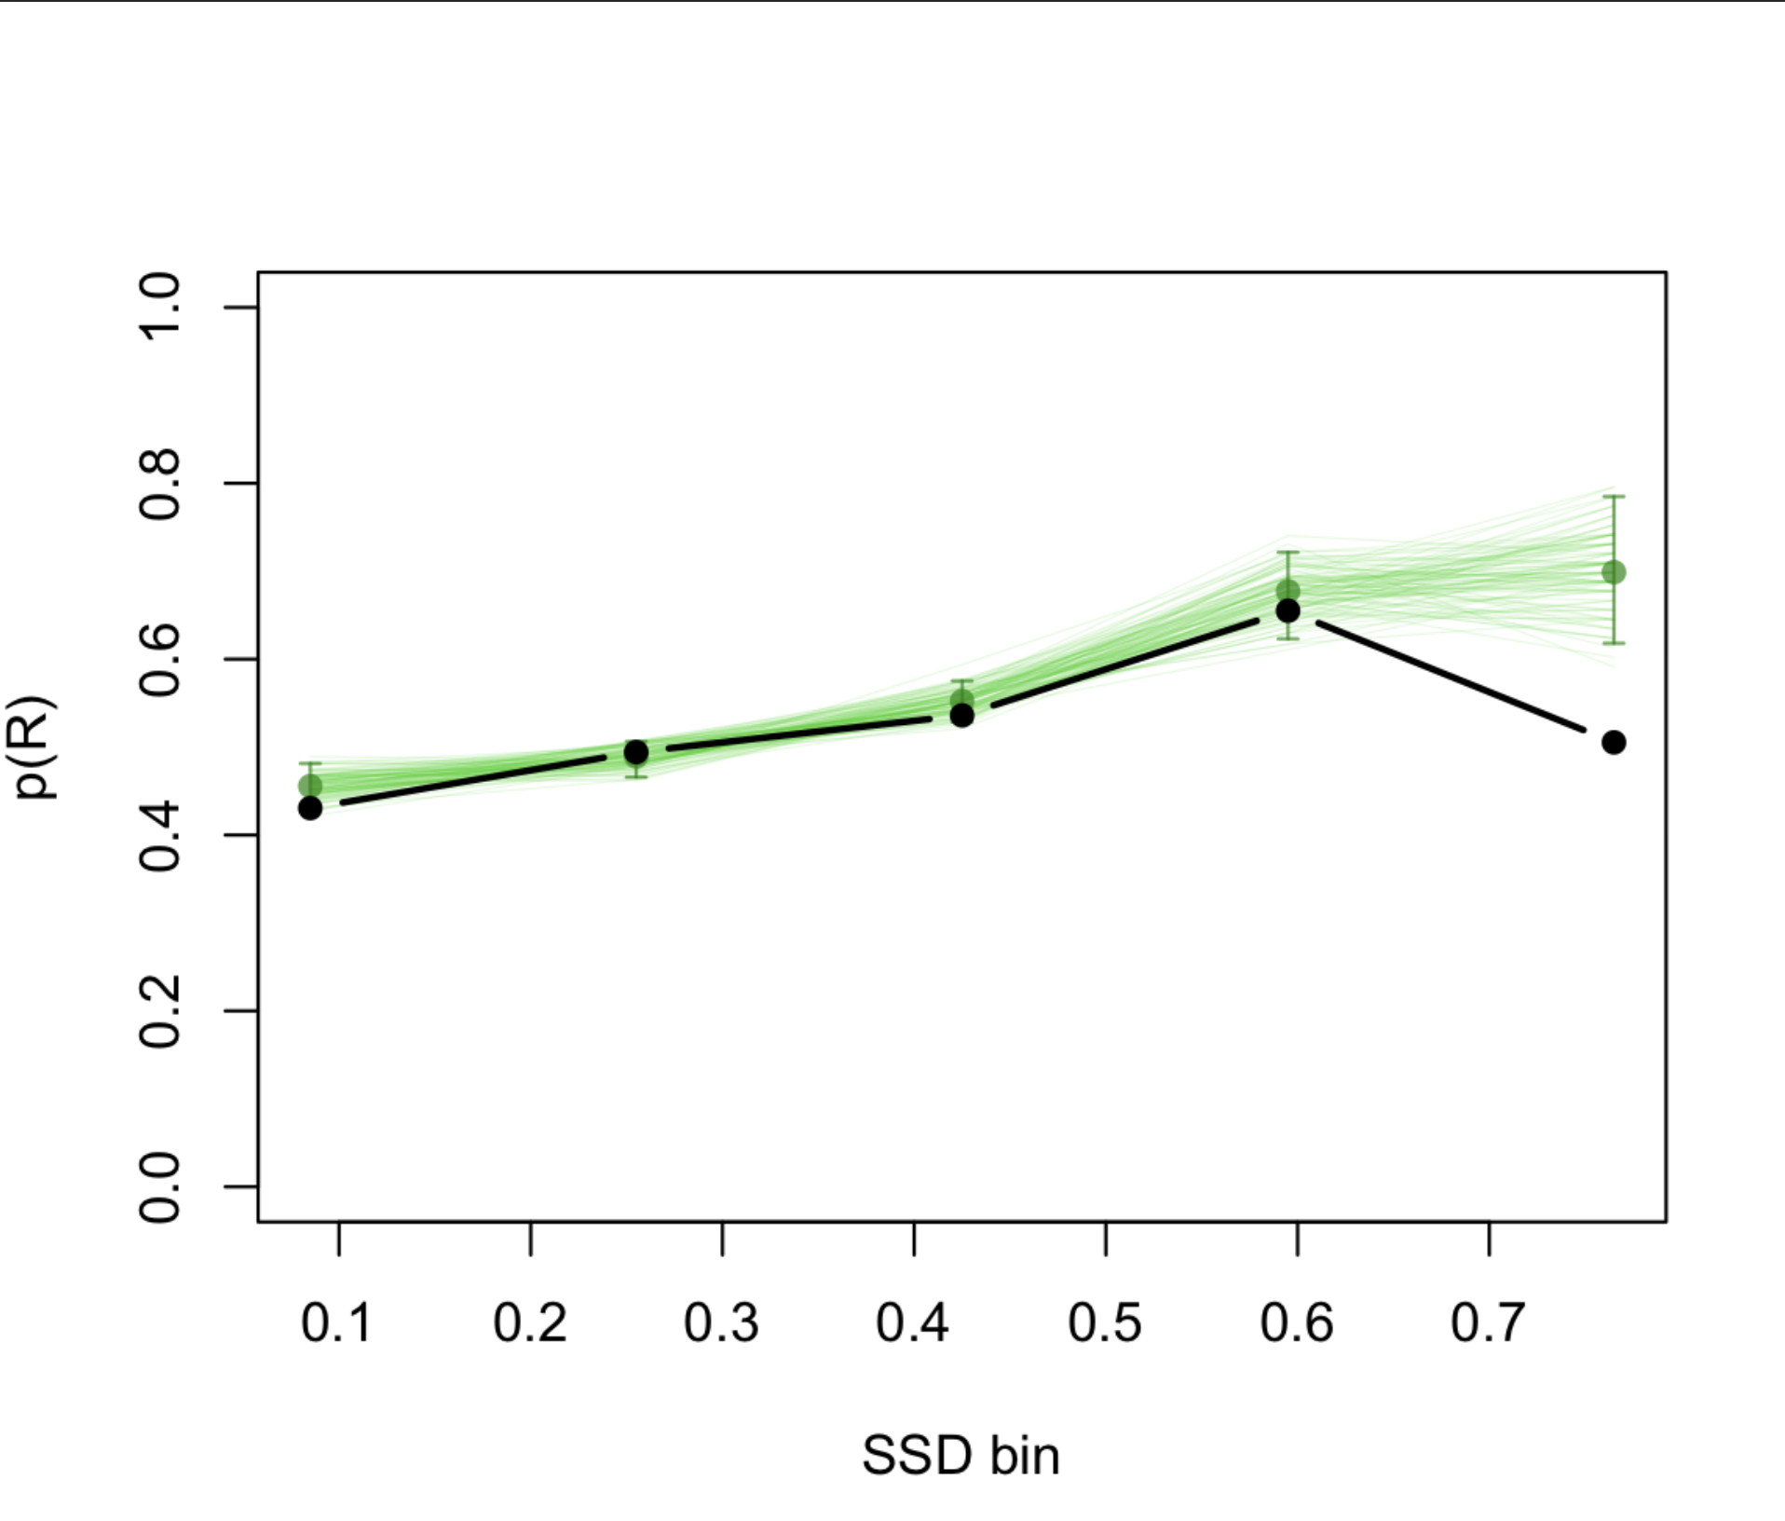
Application 3: Stimulus Selective Stopping
Participants respond to direction of arrow
On some trials after a delay a signal appears:
50% ignore signal
50% stop signal

Slide 45
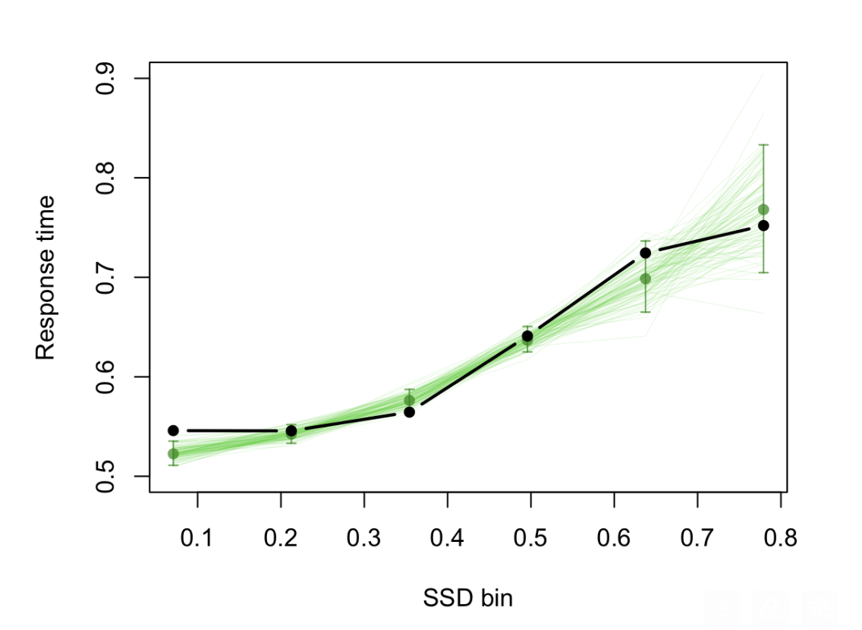
Application 3: Stimulus Selective Stopping
Participants respond to direction of arrow
On some trials after a delay a signal appears:
50% ignore signal
50% stop signal

Slide 46
Discussion
Generalized racing framework
Translate verbal hypotheses into model structure
User-friendly and efficient R package
Currently working on integrating into EMC2

